Slide 1


Discovering the Pot of Gold in India
Sumit Saran
ssaran@ss-associates.co.in

Slide 2
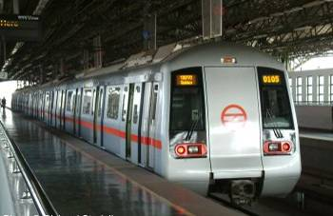

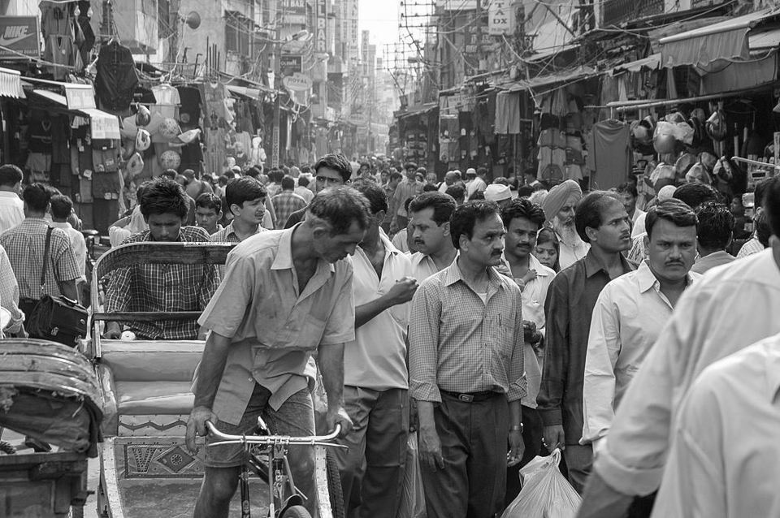
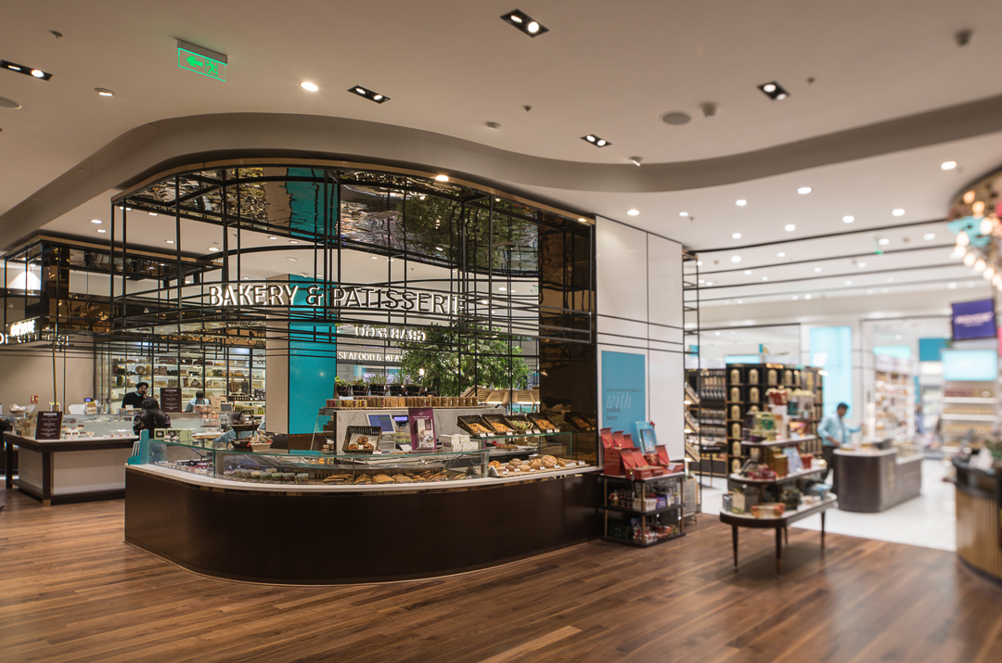
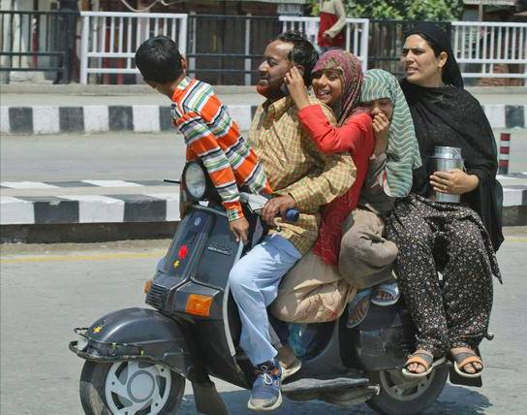
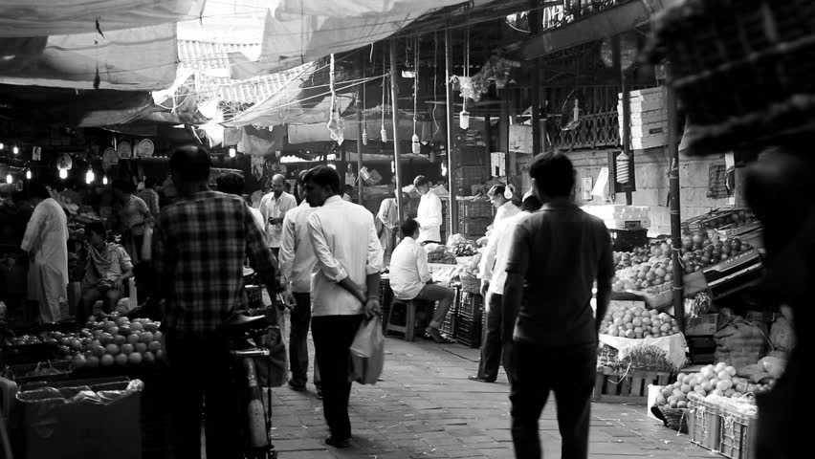
Understanding India is not Easy

Slide 3
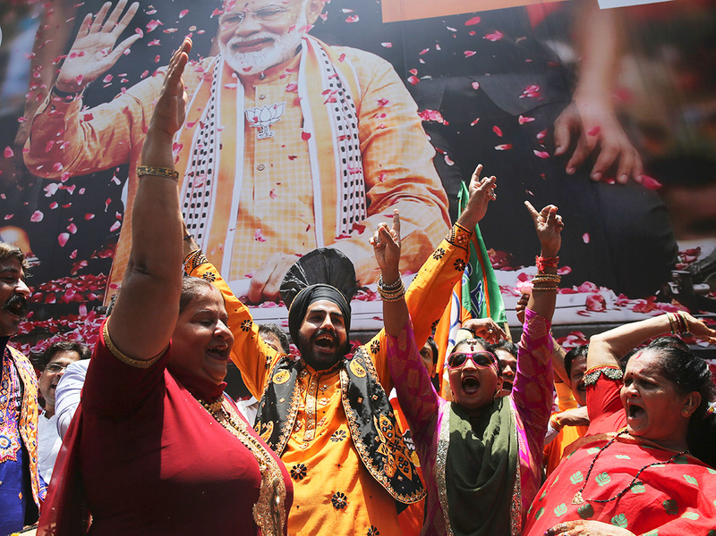

Slide 4
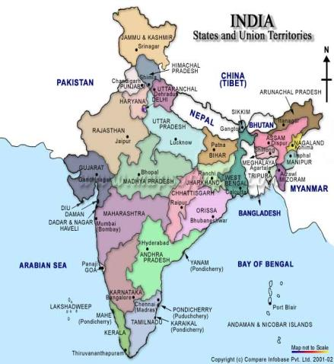
India is Complex, Diverse and Booming
India At a Glance
Population | 1.3 Billion
Consuming Class | 250 – 300 Million
GDP Growth Rate | 7.0 % (Approximate)
Polity | Democracy
Food Patterns | Diversified
Agriculture | Core
Regulatory | WTO Signatory
Food Market | Developing

Slide 5


Understanding India
Not a country
  A Continent
Strong Economy
  Resilient to many global turmoil
300 million consumers!
  Unified by aspiration
Small Families
  Open to change
Young population with High disposable incomes
  Willingness to spend
Media Revolution
  Part of a Global Village
Imported Food
  Niche to Mainstream

Slide 6

Indian Food Industry in a Glance
India’s Total Food Industry: US$ 258 Billion
  Projected Size: US$ 482 Billion by 2020
Average growth rate: 20%
World Ranking: 12th-largest food consumer
  Projected Ranking: 5th-largest consumer food market by 2025

Slide 7
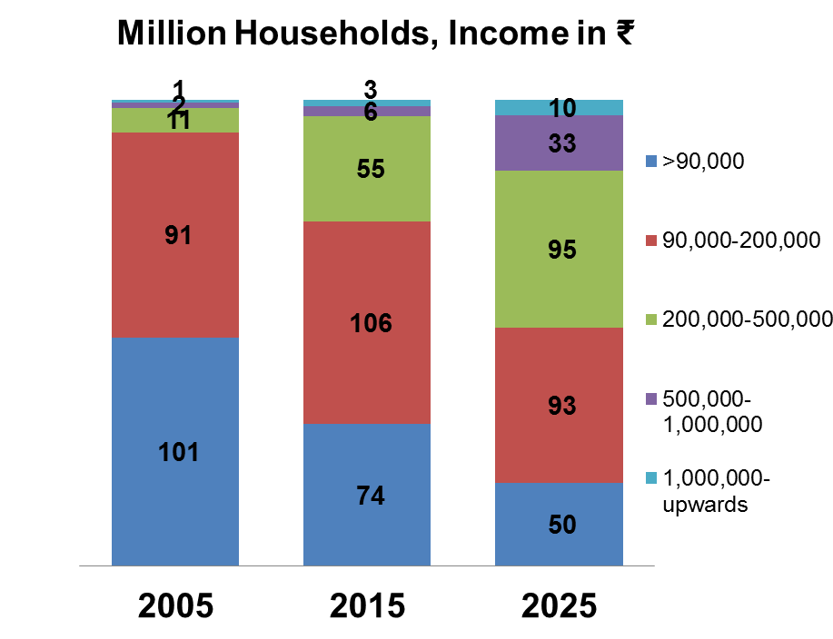
Indian Consumer Base
Source: McKinsey Global Institute Projections

Slide 8
Why India’s Consumer Is A Mosaic
 | European Union | India
Comprises of | 28 countries | 29 States, 7 Union Terr.
Area | 4.08 million km² | 3.3 million km²
Population | 511+ million | 1.2+ billion
Languages | 24 official, 150 minority | 22 official, 1600+ other major & minor

Slide 9
A Glimpse of Indian Retail Landscape

Slide 10
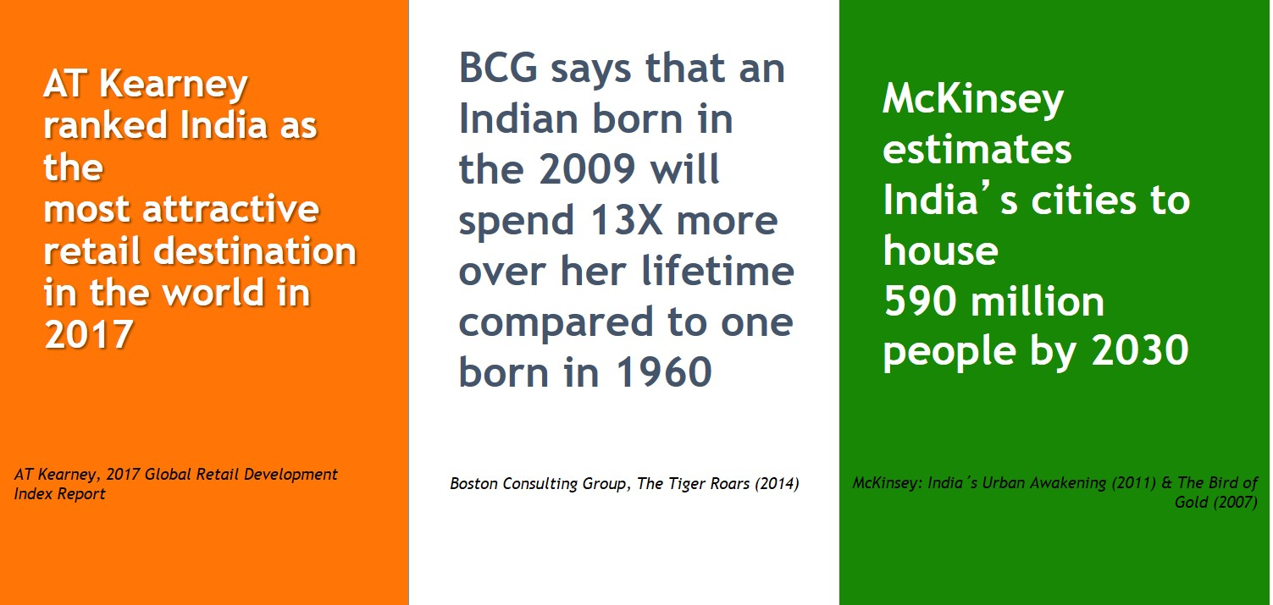

Slide 11

Retail Landscape in India
Myriad of Formats
  Traditional Roadside and Pushcart
  Home Delivery
  Modern Organized
  Green Grocery
  Cash and Carry
  Online
  Leapfrogging
  Fast changing

Slide 12
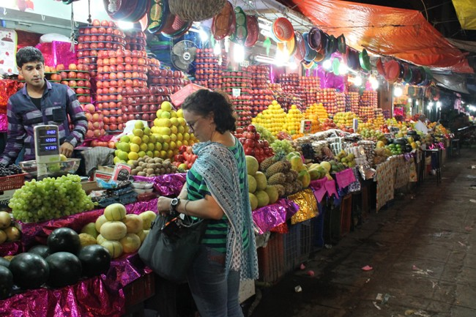
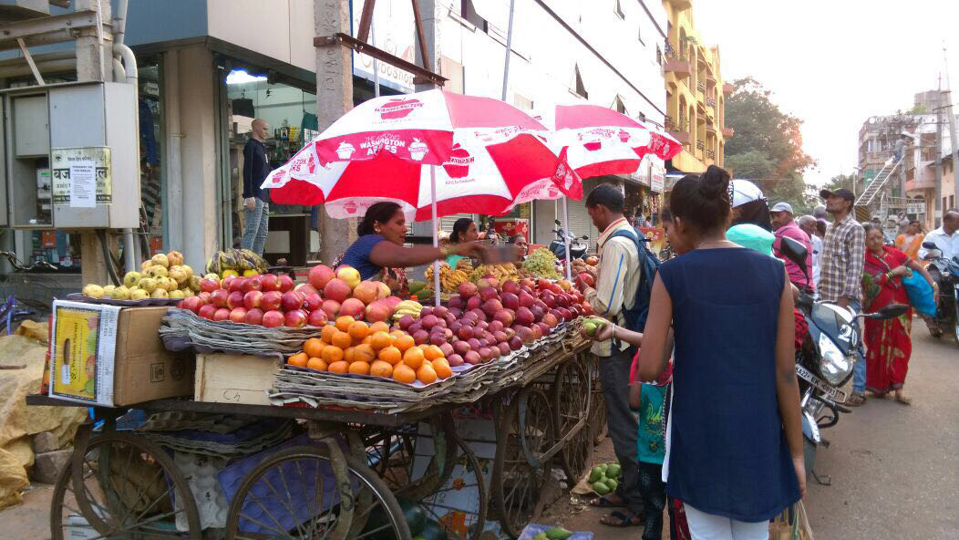
Traditional Retail – Roadside and Pushcart

Slide 13
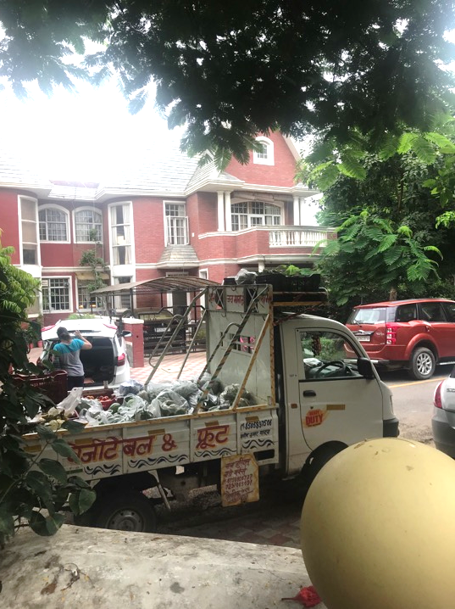
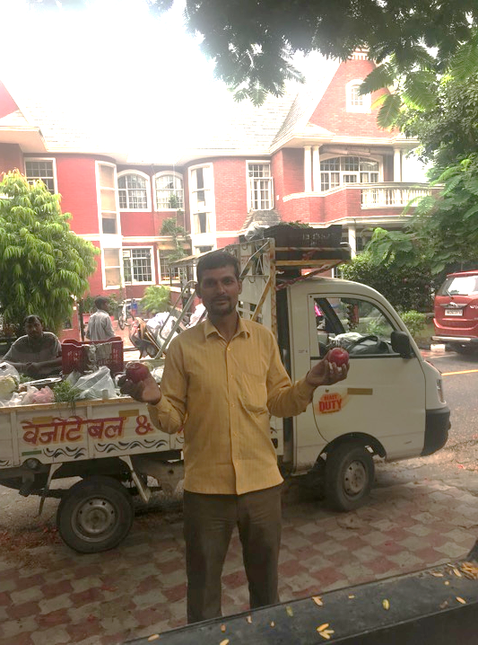
Traditional Retail – Home Delivery

Slide 14

























Retail – Modern Organized Chains

Slide 15
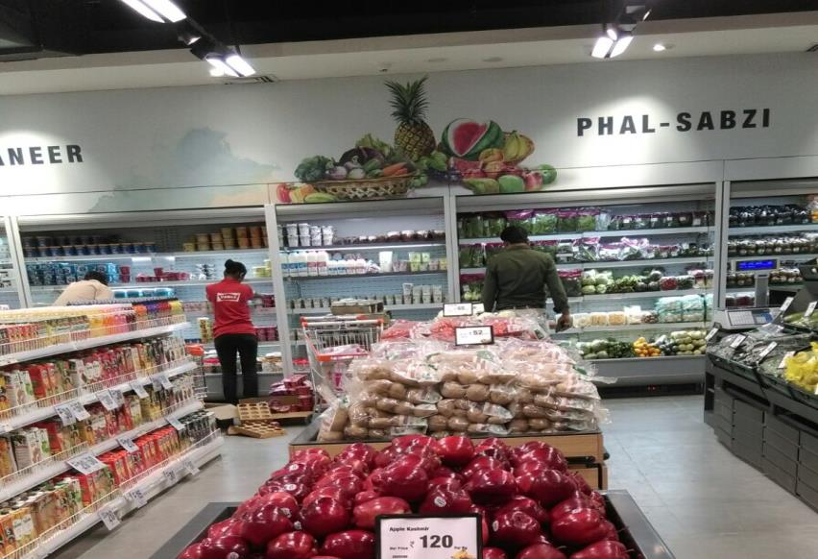
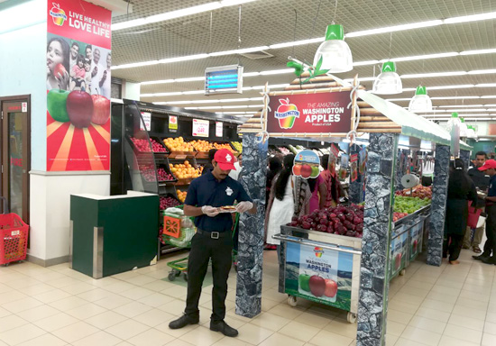
Hypermarkets and Supermarkets

Slide 16
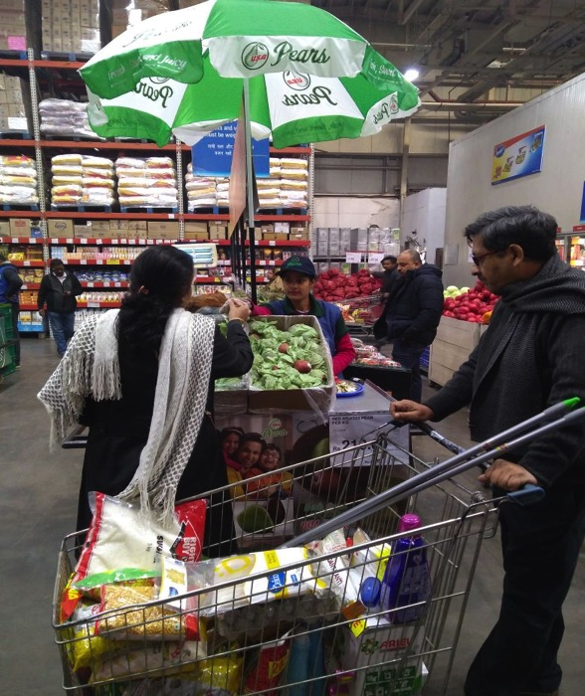
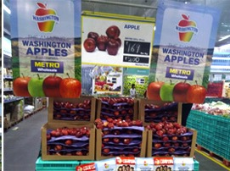
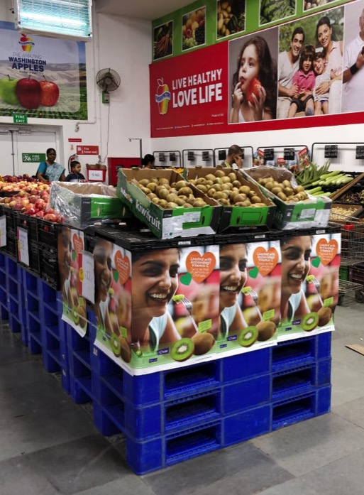
Retail - Cash and Carry

Slide 17
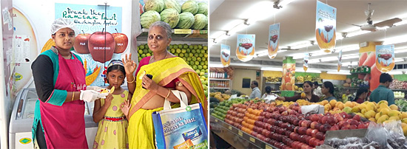
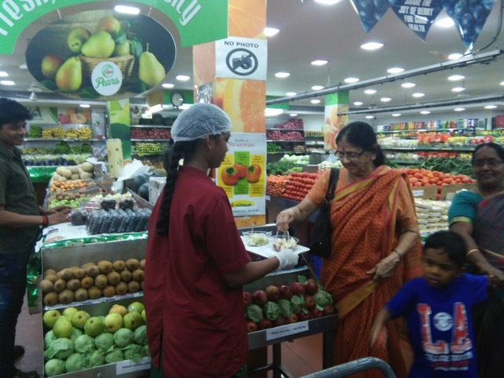
Retail - Green Grocery

Slide 18
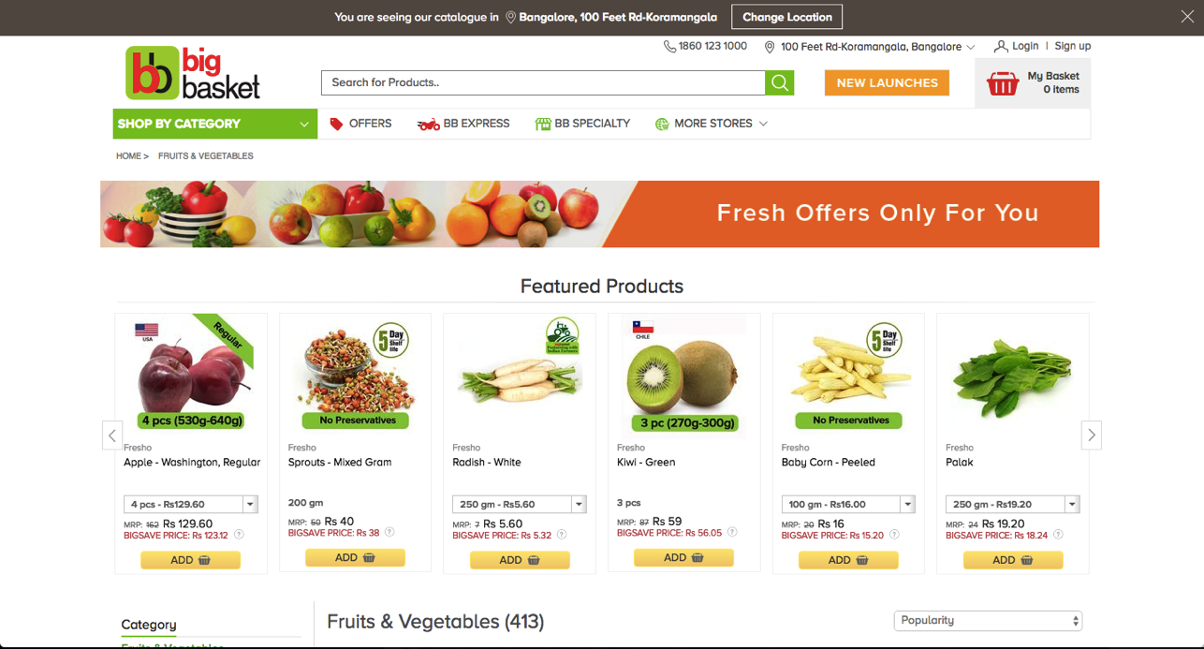
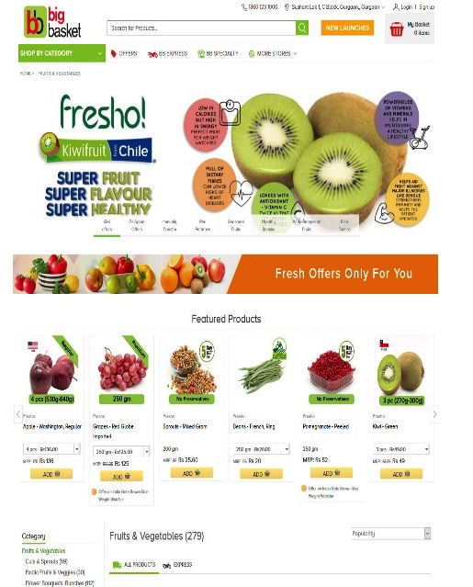
Retail - Online

Slide 19

Trade Route – Importer & Wholesaler
Wholesaler
Retailer
Consumer
Imported
Importer

Slide 20
India and Berries
Tremendous Market Opportunity
Especially for Blueberries
  Imports
  Local Production
No Data to Support

Slide 21
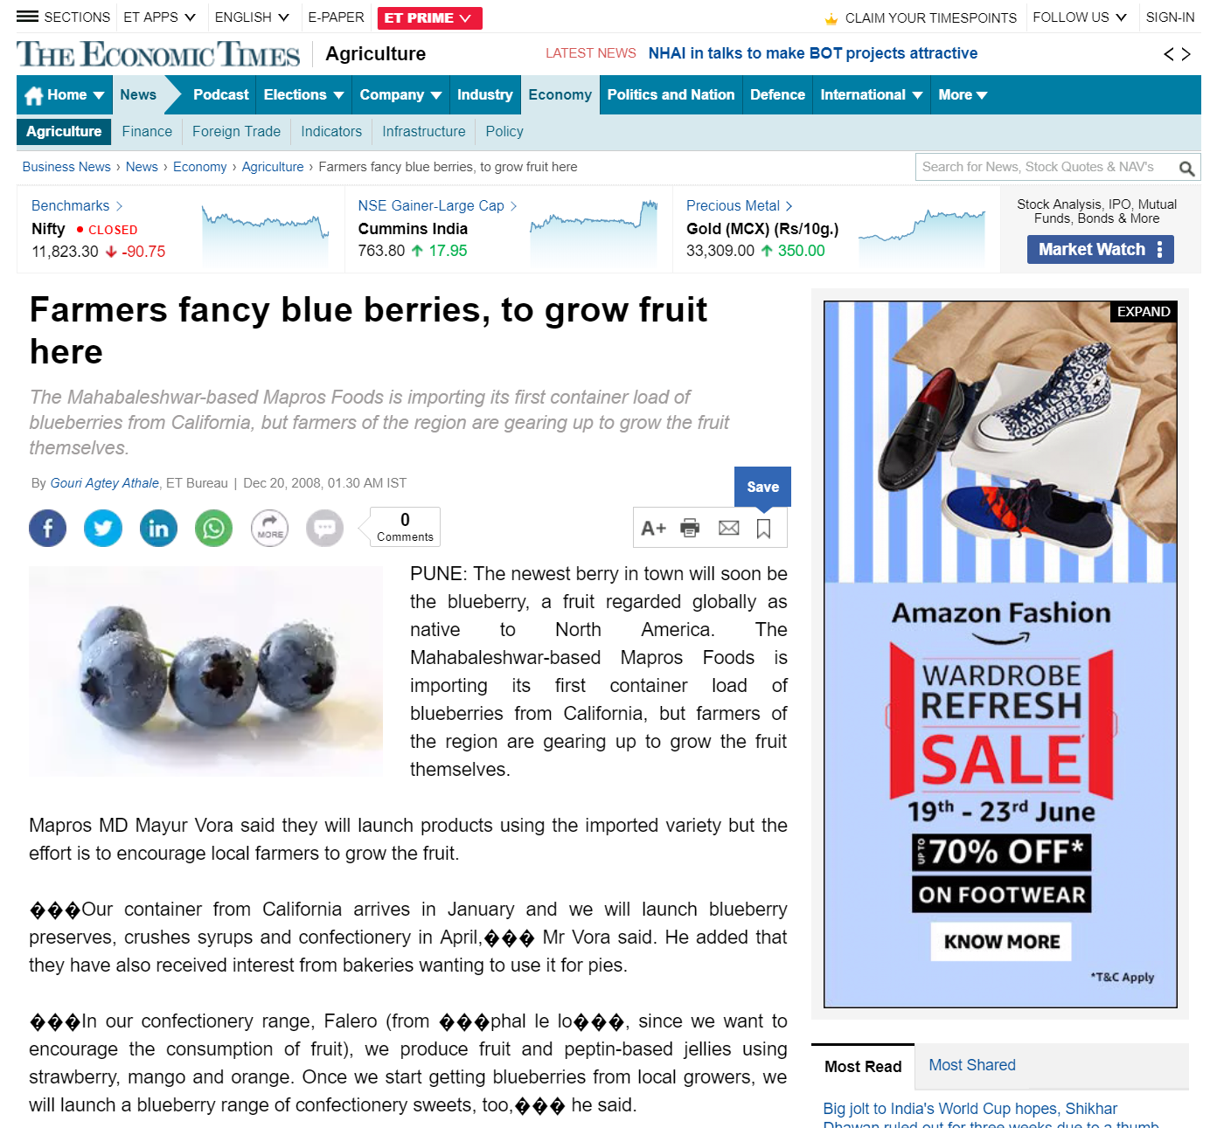
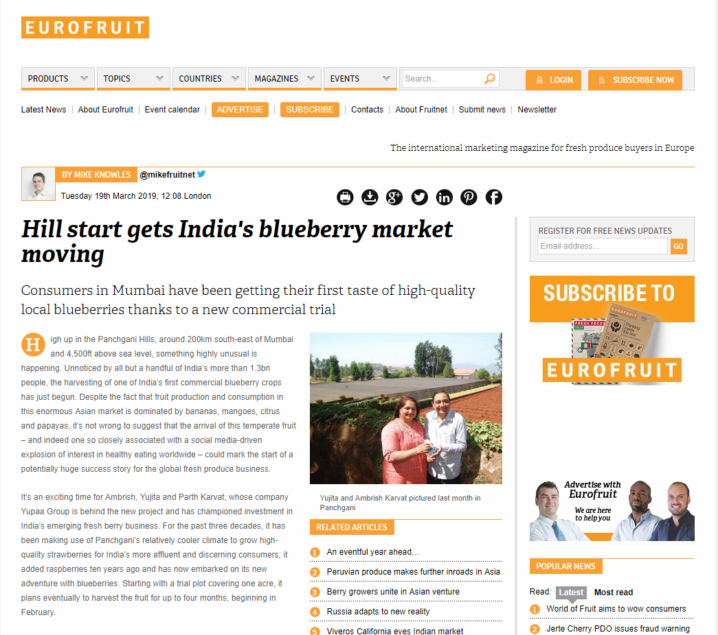
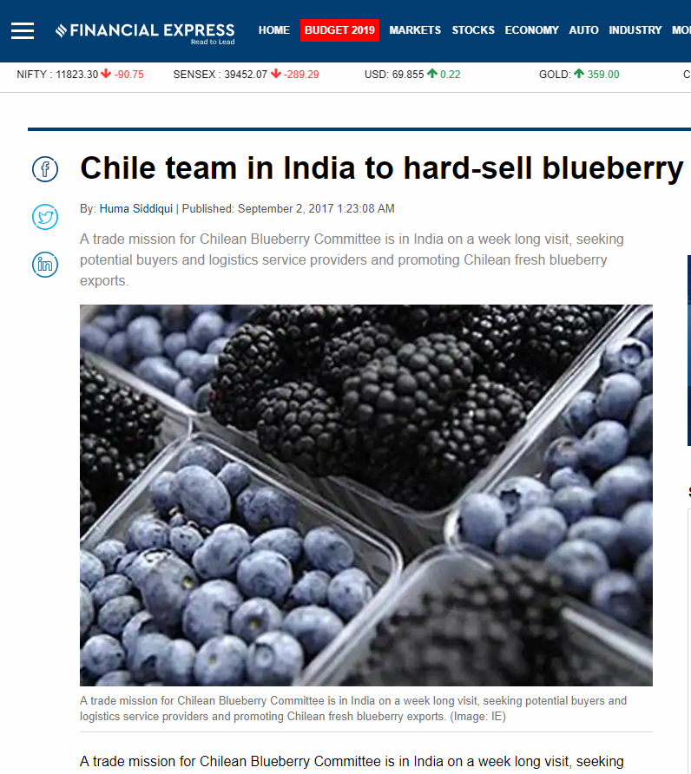
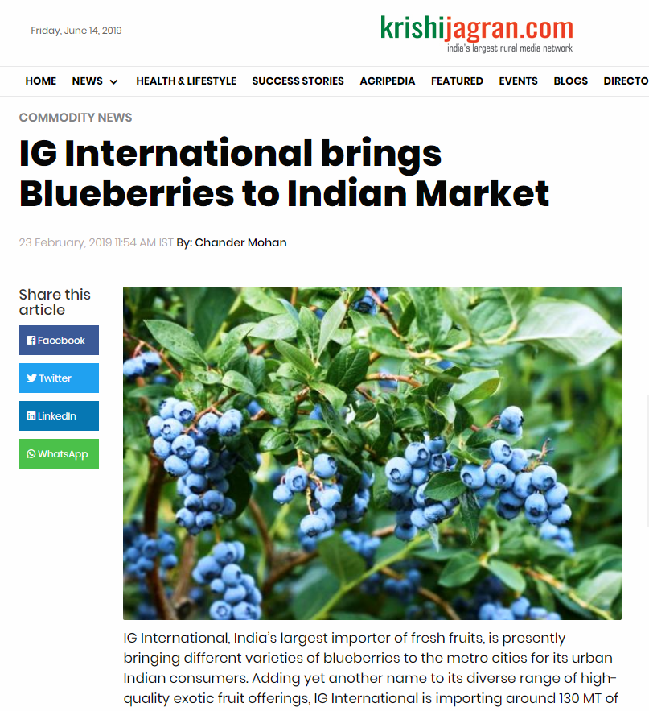
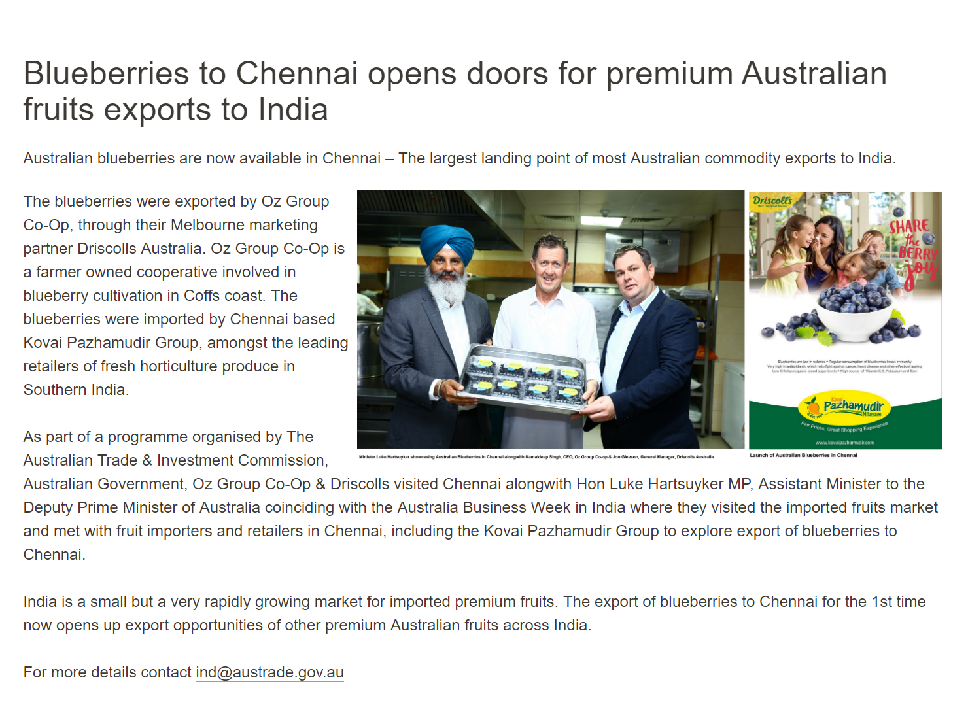
Some Recent Developments

Slide 22

Market Strategy
India is at an inflection point

Slide 23

10 Simple Mantras For Discovering the Pot of Gold in India

Slide 24
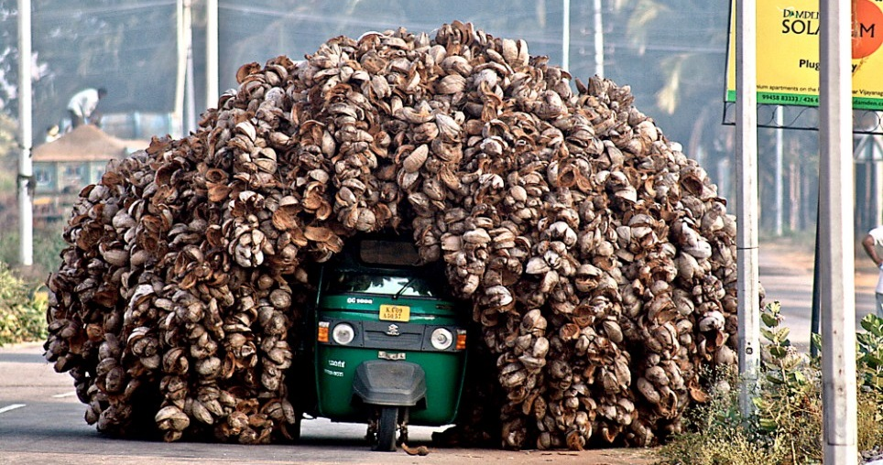
1. Troubles will not go away… Accept it
Growth will continue… The Opportunity in Now… Embrace it!!

Slide 25
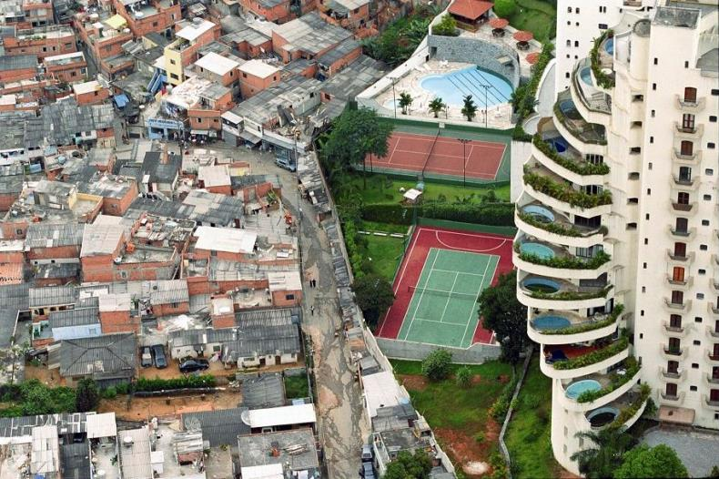
2. Define your India
It is critical to have a clear market strategy

Slide 26
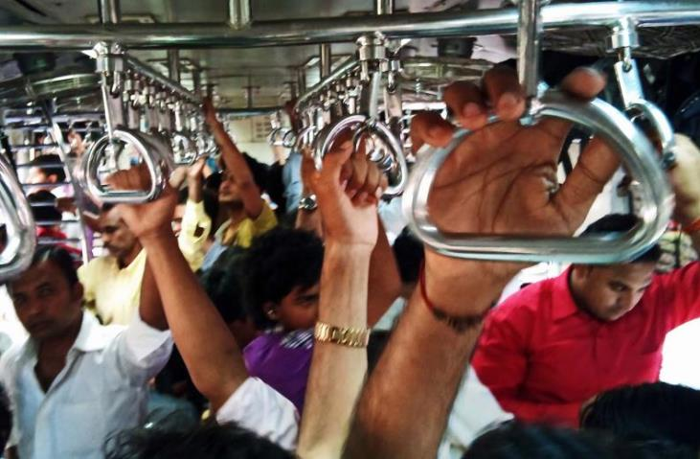
3. There is Always Room in India
It may look cluttered but you can find your way

Slide 27
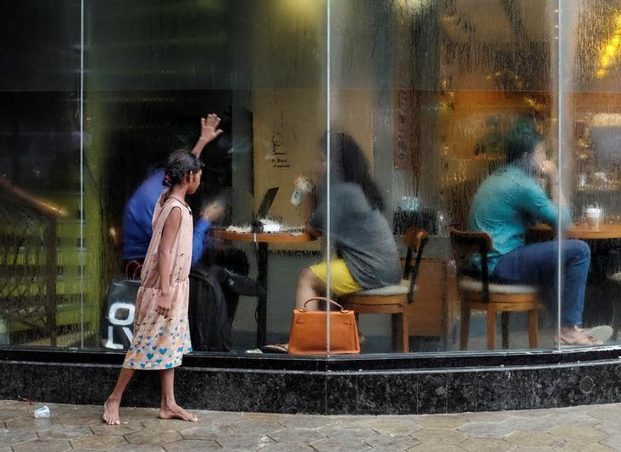
4. India is What India Is
There is nothing artificial

Slide 28
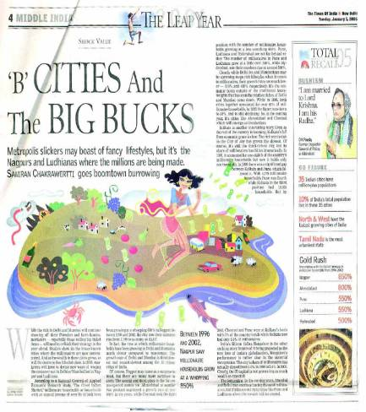
5. India is Beyond its Metros
Go Deep… Go Regional

Slide 29

6. Establish Partnerships with a 360° View
Maintain momentum
Product Identification
Review and Adjust
Partner Identification
Implement Promotions
Long term Market Strategy
Correct Partner will be Key to Success

Slide 30

7. Reach Out Or You Will Be Lost
Correct Promotion Strategy is Critical

Slide 31

8. Firecrackers often Fail
Candlelight Succeeds

Slide 32
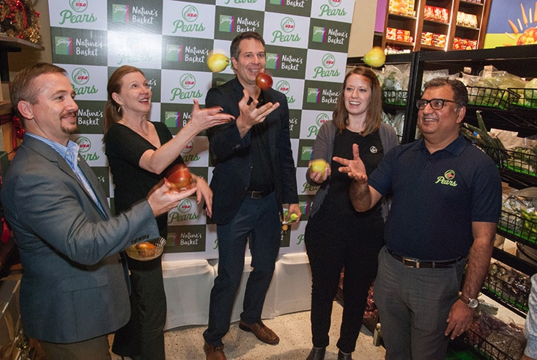
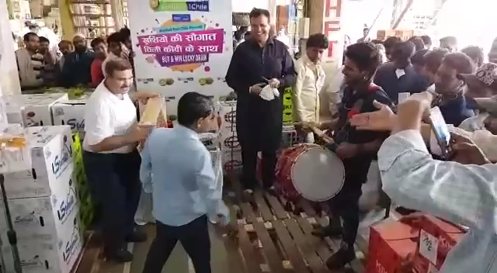
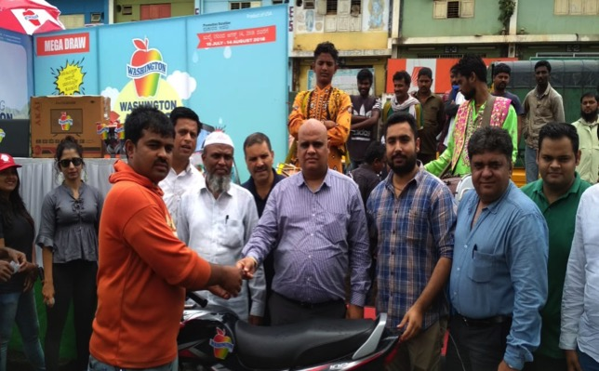
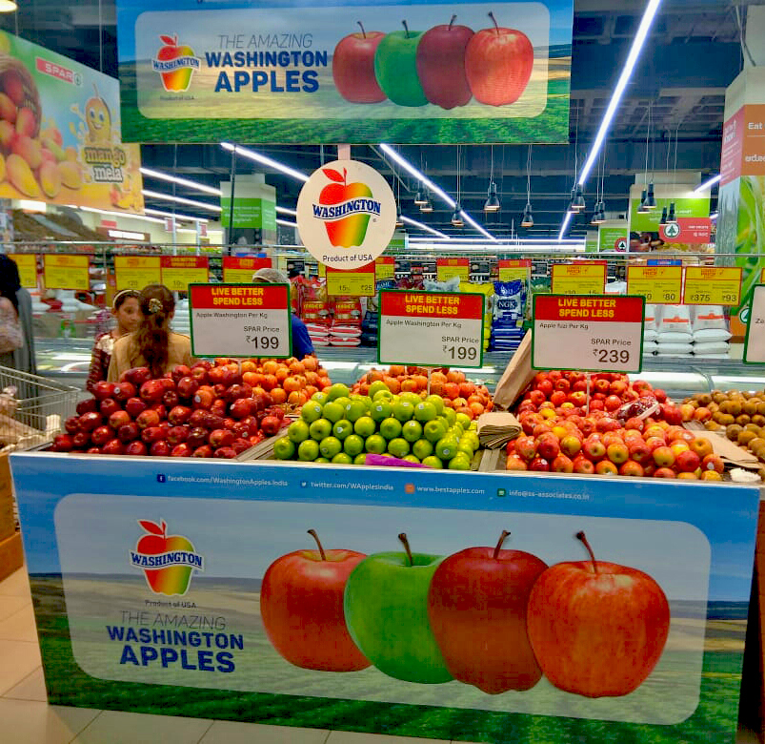
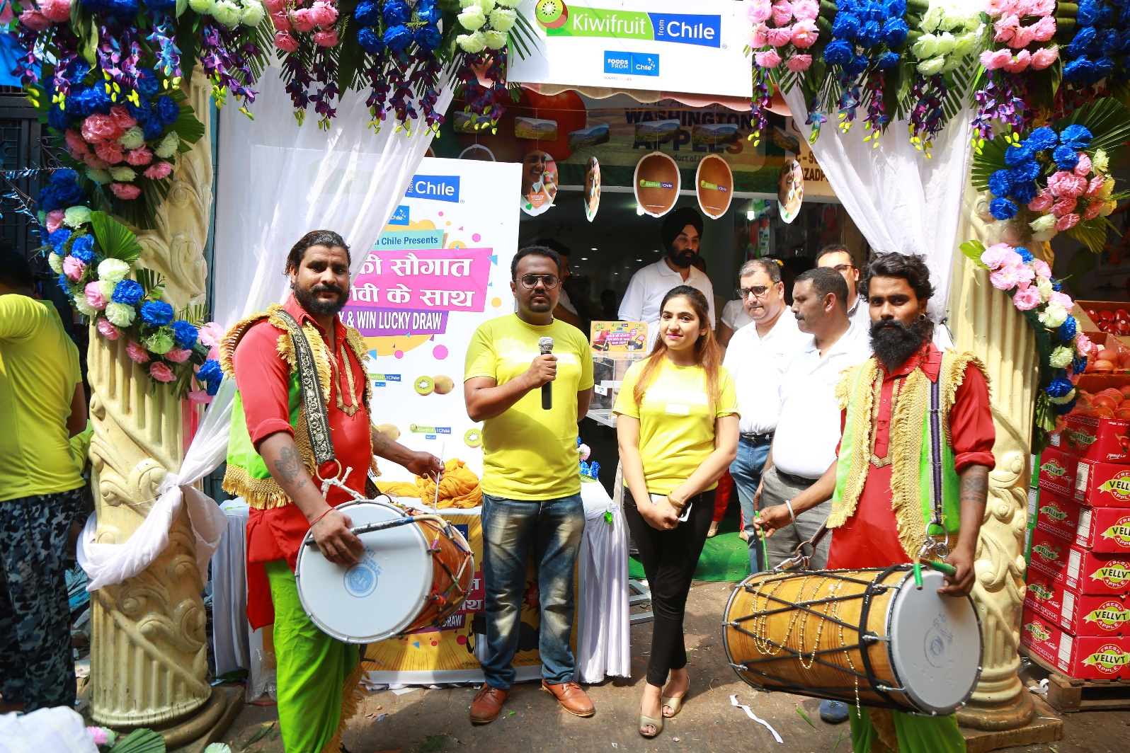
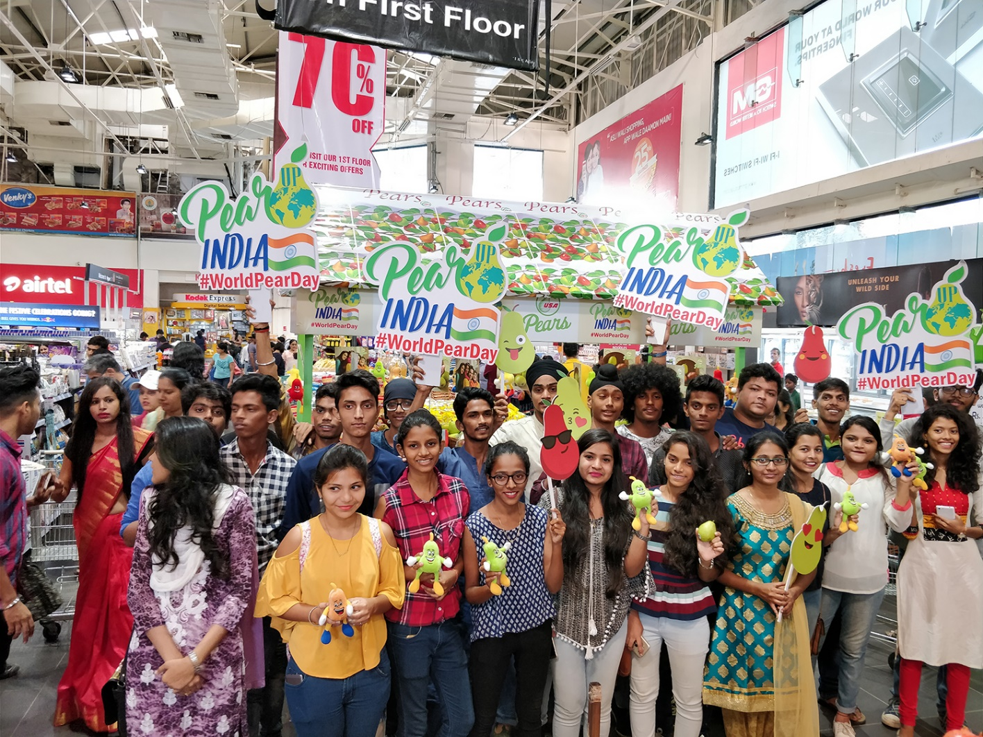
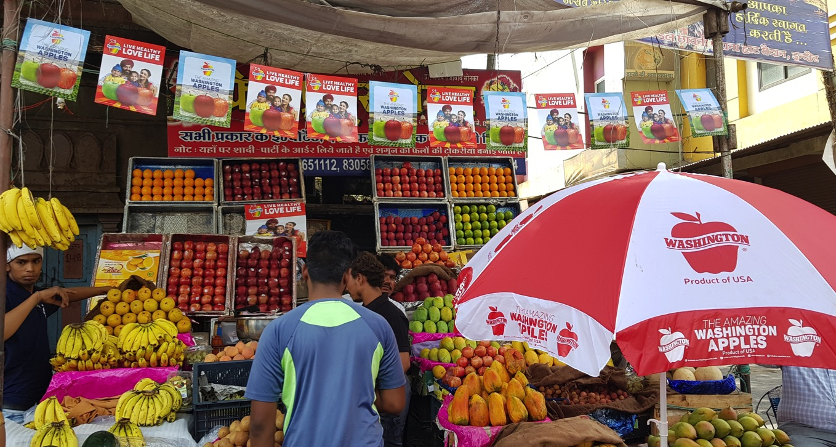
Promotion Glimpses

Slide 33

9. Have a Long Term Plan
It is the only plan

Slide 34

10. There is Life Beyond Google
Come and Smell The Chai for Yourself!

Slide 35
Thank You
Sumit Saran
SS Associates
#25 (Ground Floor) | JMD Megapolis
Sohna Road | Sector - 48
Gurugram – 122 018 INDIA
Phone: +91 (124) 496 8556
Mobile: +91 98102 73513
Email: ssaran@ss-associates.co.in

